Slide 1

Lending Club Case Study
Swaraj Kumar
Gagan Banga

Slide 2
Problem Statement
Summary
Summary
Outcome/ Approach
Solve a business problem using EDA for the consumer finance company which specializes in lending various types of loans to urban customers.
To develop a model that assists the company to make informed decision based on the past patterns of the applicants
Data Understanding/ Cleaning
Data Analysis
Recommendations

Slide 3
Analysis Approach
Drop column with null values, random values or single category values
Convert values to proper int, and float values
Correlation to check the impact/ effect of two variables on each other or a third variable
Data Analysis/ Understanding
Data Clean Up
Univariate Analysis
Bivariate Analysis
Results Summary
Go through the data provided and understand/ import
Check distribution and frequencies of various numerical and categorical variables
Create derived variables
Publish insights and observations

Slide 4
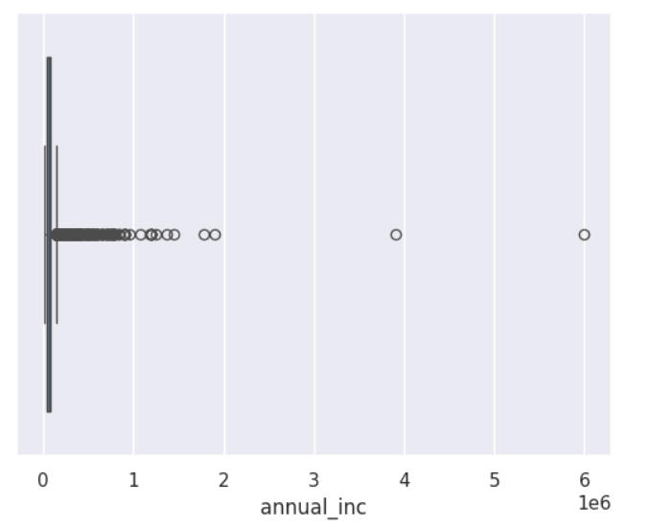
Range of outliers
Data distribution indicates presents of outliers, explore the range of outliers using box plot
Outliers are above the 97th percentile, so we removed them

Slide 5
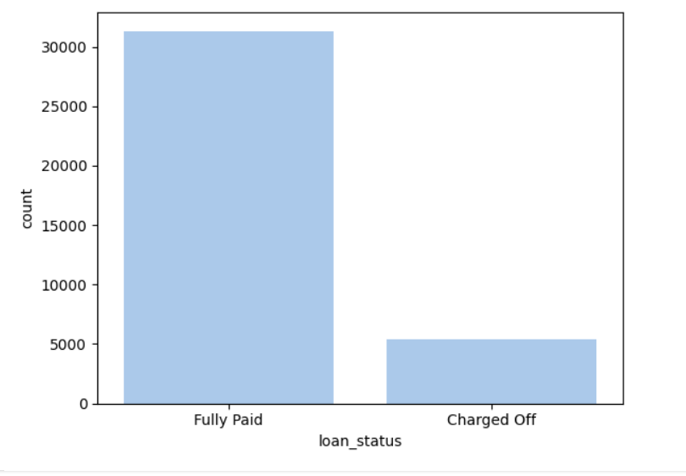
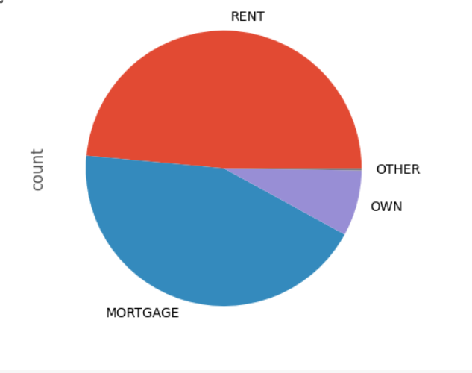
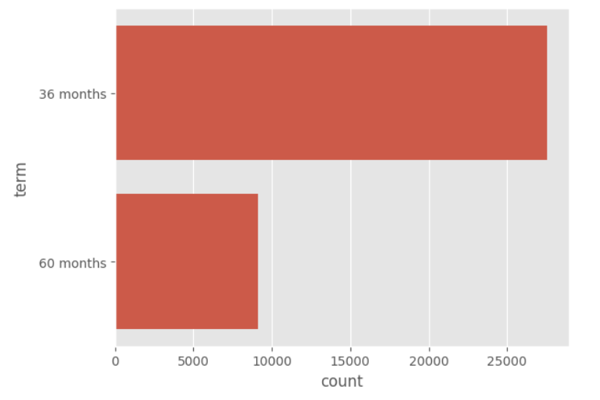
Univariate Analysis
This count plot displays the distribution of loan terms. It helps understand the prevalence of different loan durations
This count plot visualizes the distribution of loan statuses in the dataset. It helps identify the proportion of loans that are fully paid, charged off, or in default.
This count plot visualizes the distribution of loan statuses in the dataset. The pie chart shows the distribution of home ownership statuses among borrowers. It provides insights into the most common types of home ownership in the dataset. identify the proportion of loans that are fully paid, charged off, or in default

Slide 6
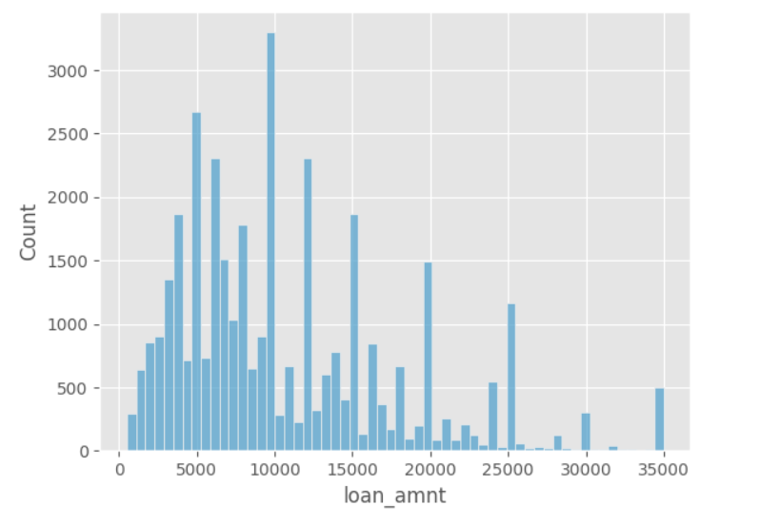
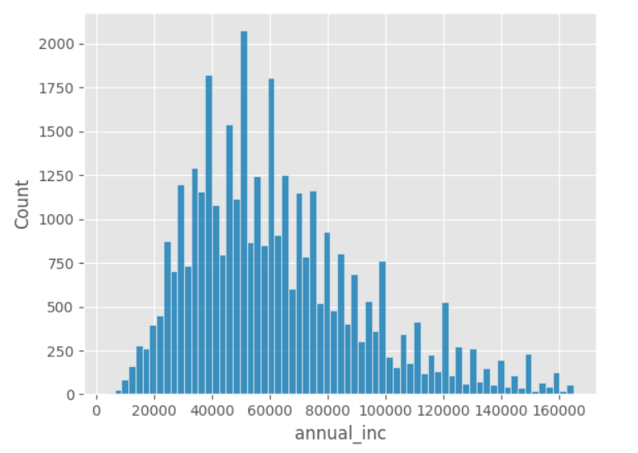
Univariate Analysis
The histogram shows the distribution of loan amounts. It highlights the range and frequency of loan amounts requested by borrowers.
This histogram visualizes the distribution of annual incomes of borrowers. It helps identify the income levels of most borrowers

Slide 7
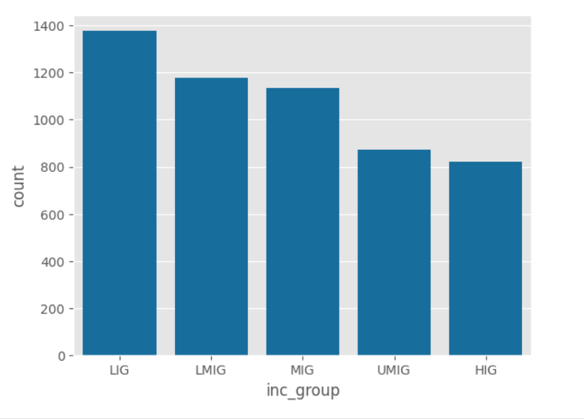
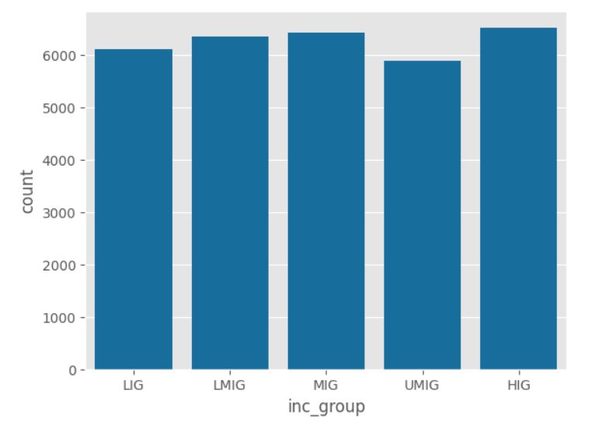
Datasets based on Loan Status for comparison
The count plot shows the distribution of income groups among defaulted loans. It provides insights into which income groups are more likely to default.
This count plot displays the distribution of income groups among paid-up loans. It helps understand which income groups are more likely to repay their loans.

Slide 8
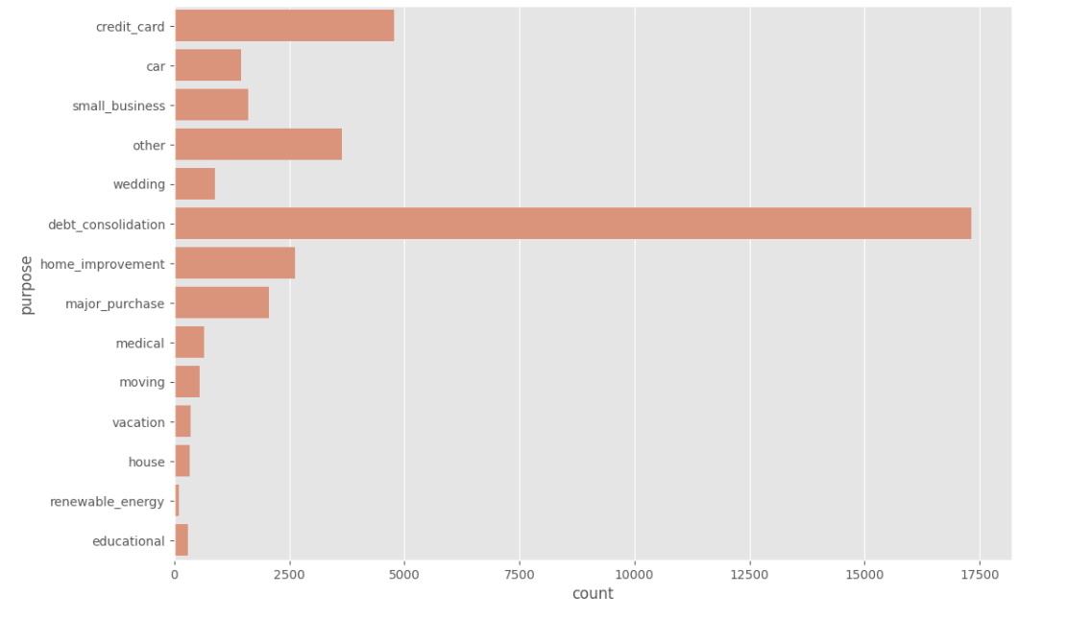
Univariate Analysis
The count plot visualizes the distribution of loan purposes. It highlights the most common reasons borrowers take out loans.

Slide 9
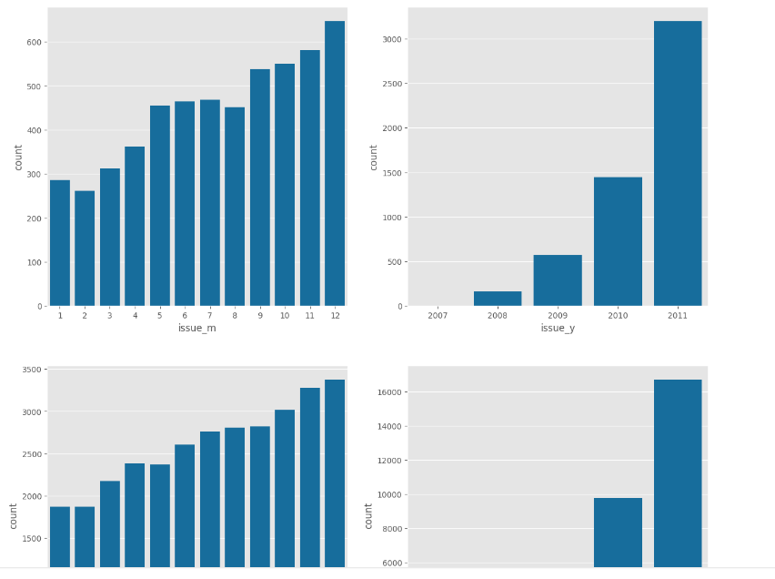
Univariate Analysis
These subplots show the distribution of issue months and years for both defaulted and paid-up loans. They help identify any seasonal or yearly trends in loan issuance and repayment behavior.

Slide 10
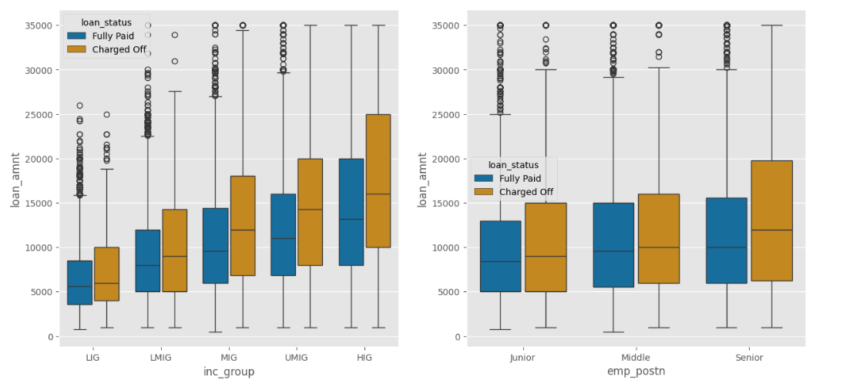
Bivariate Analysis
This plot shows the distribution of loan amounts across different income groups, segmented by loan status.
This plot illustrates the variation in loan amounts based on different employment positions.

Slide 11
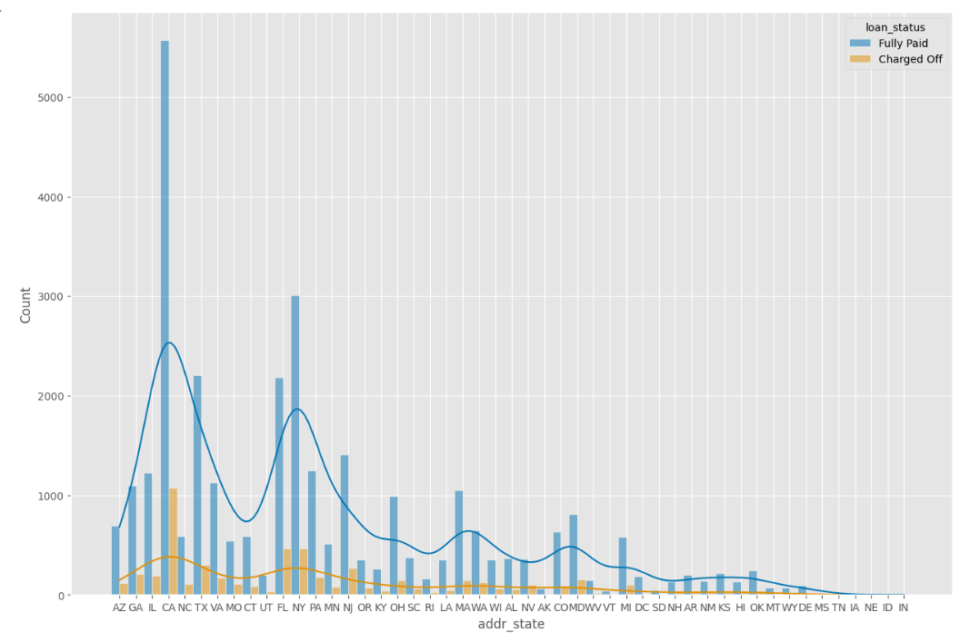
Bivariate Analysis
This histogram displays the distribution of loans across different states, with a distinction between loan statuses

Slide 12
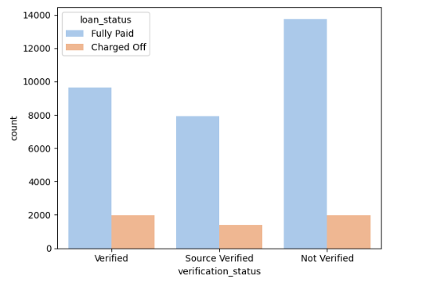
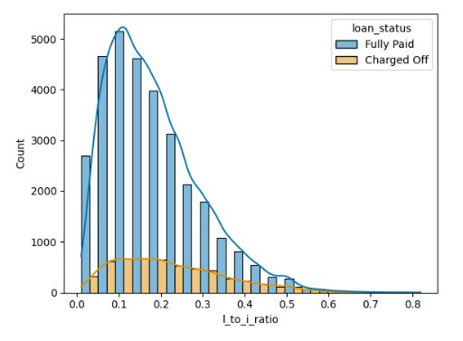
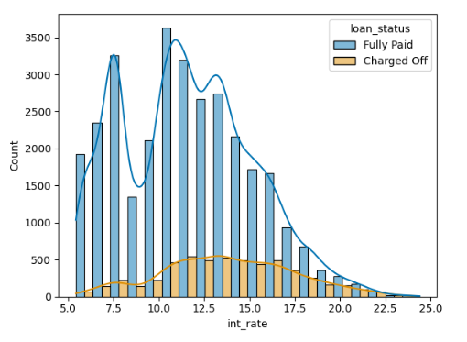
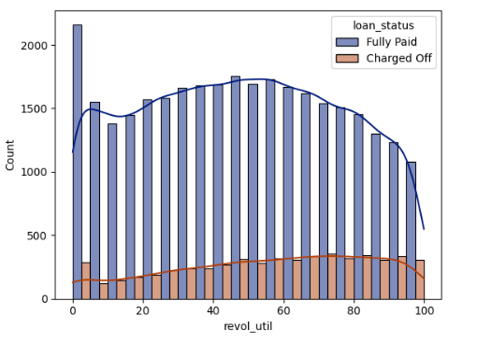
Bivariate Analysis
This count plot shows the count of loans based on verification status, segmented by loan status
This histogram represents the distribution of the loan-to income ratio, categorized by loan status. It helps in understanding the relationship between borrowers’ income and the loan amounts they receive
This plot shows the distribution of interest rates for loans, segmented by loan status
This histogram displays the distribution of revolving utilization rates, categorized by loan status

Slide 13
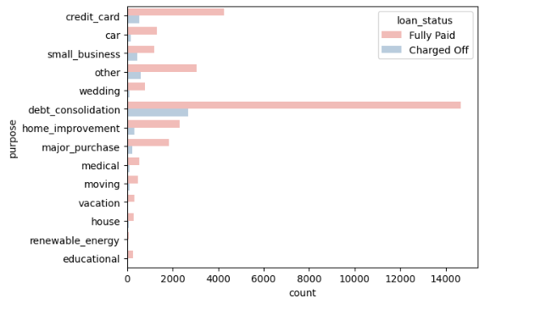
Bivariate Analysis
This count plot shows the count of loans for different purposes, segmented by loan status. It helps in identifying the most common reasons for taking loans

Slide 14
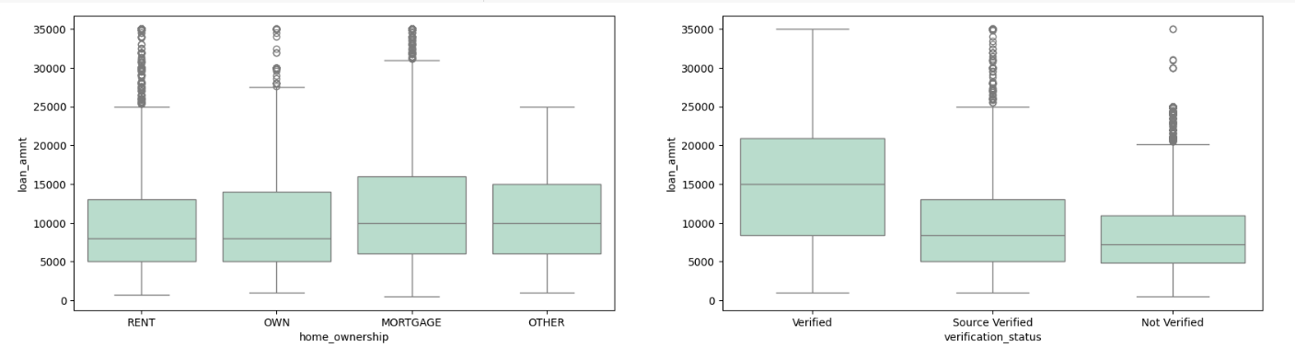
Bivariate Analysis
This plot illustrates the variation in loan amounts based on home ownership status. It provides insights into how owning a home affects the loan amounts borrowers receive
This plot shows the distribution of loan amounts based on verification status. It helps in understanding the impact of verification on the loan amounts.

Slide 15
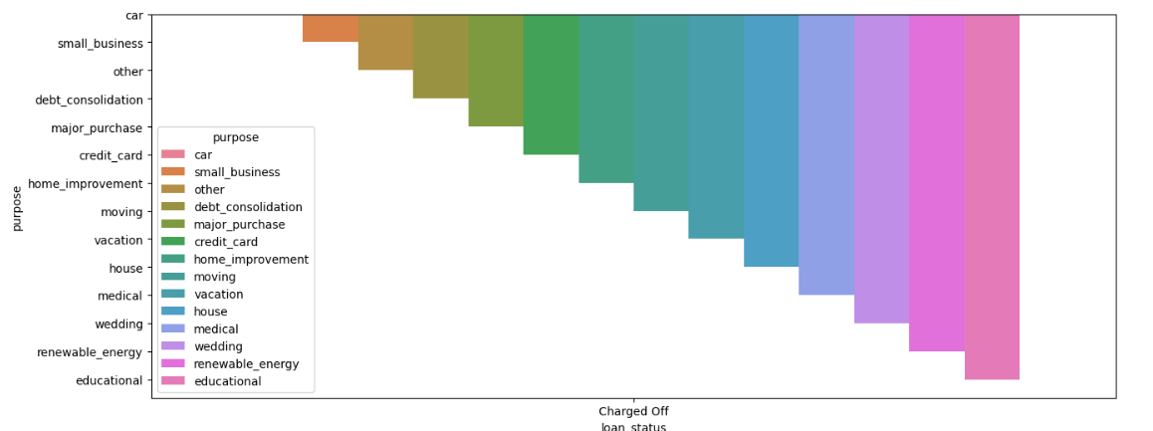
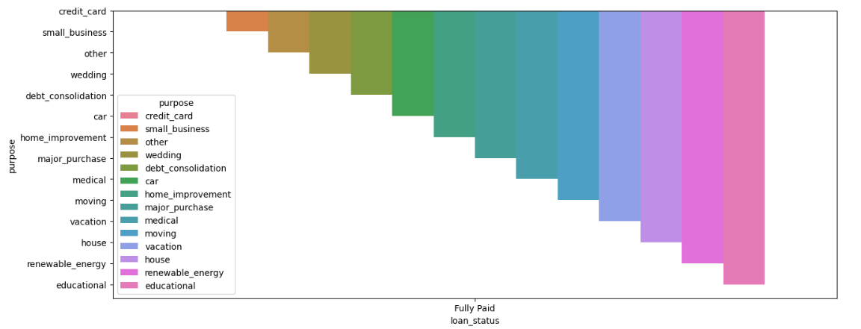
Bivariate Analysis
This bar plot displays the distribution of defaulted loans based on their purpose. It helps in identifying which loan purposes have higher default rates
This bar plot shows the distribution of paid-up loans based on their purpose. It provides insights into which loan purposes are more likely to be fully paid

Slide 16
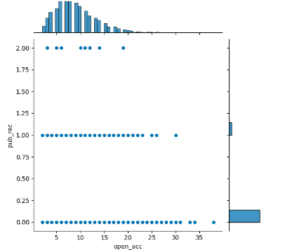
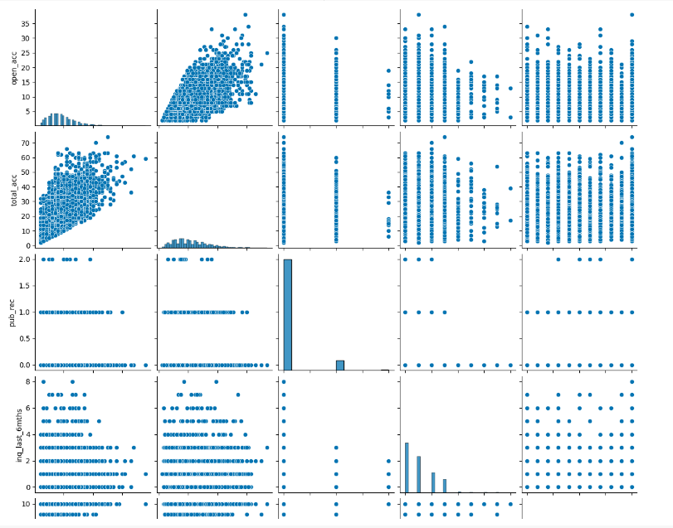
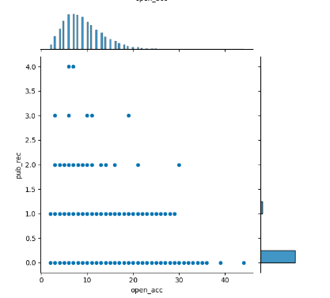
Bivariate Analysis

Slide 17
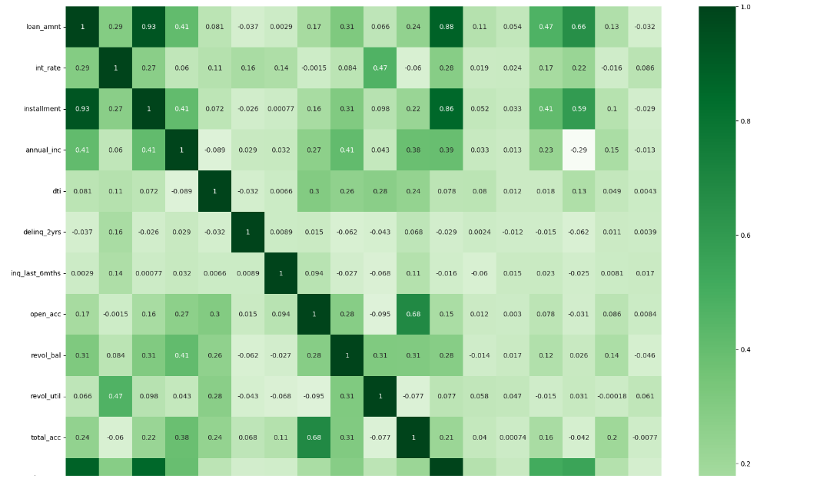
Conclusion
Based on the Exploratory Analysis of given data, we could infer that
Borrowers who have a loan to income ratio of more than 30% are very likely to default
Borrowers having high rate of revolving utilization are likely to default
Loans taken for purposes Debt Consolidation, Credit Card, Small Business and Other are very likely to default
Borrowers with employment tenure over have a risk of default
Borrowers with over 100K annual income are likely to default compared to lower income group
There is no relationship between the non demographic data and the risk of default

